Slide 1
Designing studies
Chapters 1, 2

Slide 2
Learning objectives
Identify if a given data collection procedure is an observational study or randomized, comparative experiment
Define experimental unit, observational unit, treatment factor, etc.
Explain what pseudo-replication is
Explain purpose of randomization

Slide 3
Scientific method
Organized approach to avoid false starts and incomplete answers to research questions
Hypothesize mechanism for
what was observed
Observe state of nature
Collect data that will clearly
support/refute hypothesis
Update hypothesis
Reject?
Analyze data to confirm or reject
hypothesis

Slide 4
Experimentation Flow Diagram
Hypothesis → data collection phase: clearly state the objectives of experiment
Define Objectives
Choose Study Design
Data collection procedure
Model for Data Analysis
Analysis of Data and Interpretation of Results
Conclusions

Slide 5
Defining objectives
“What scientific questions hoping to answer?”
Data and analysis methodology to answer question?
Argue how the pairing can answer broad questions
What is the statistical objective?
Understand distribution of a single response?
Determine relationships between multiple variables?
Build a predictive model?
Determine causes of variation of a response?
Find conditions that optimize response?

Slide 6
Does Smoking Cause Lung Cancer? Study Design 1
Does frequent smoking of cigarettes cause lung cancer?
Study design idea: randomly sample many smokers and nonsmokers and compare the relative proportions of those with lung cancer
Analysis goal: determine whether smoking causes an increase in the probability of lung cancer
Is there an analysis that could give valid causal inferences?

Slide 7
Smoking Study Design 1: Two-Sample Proportion Test
Two-sample proportion test and find a statistically-significant difference between the proportions
Does this tell us smoking causes lung cancer?
If there is a causal effect, we expect difference
What else could explain the observed difference?
Random chance associated with Type I error
Any other thing that is related to or causes lung cancer such as genetics, work/home environment, age, etc.

Slide 8
Smoking Study Design 1: Regression Adjustment
Partition subjects based on extra variables and compare proportions within a group
Subjects in group influenced similarly by extra variables
Within-group differences more likely due to smoking alone
Issues:
Group sizes can vary and may be small for some cases
Accounted for every possible extra variable?
Works in theory but under a lot of assumptions
Upshot: need techniques to “adjust” for researcher’s lack of control over how subject becomes a smoker

Slide 9
Does Smoking Cause Lung Cancer? Study Design 2
What if we could assign subject to be smoker?
Yeah…you can’t do that
Let’s just pretend we can for now
Best way to assign subjects?
Limit possibility proportion differences occur due to known or unknown external variables
How to guard against variables we don’t know about?
RANDOM ASSIGMENT

Slide 10
Smoking Study Design 2: Random Assignment
Randomization reduces probability external variables are what cause differences
Guaranteed to remove effects for studies with many subjects
Still the gold standard for establishing causality
Different types of random assignments:
Completely randomized designs for unknown external variables
Block designs for some known external variables
Split plot designs for complicated assignments of treatments
“Block what you can, randomize what you can’t”

Slide 11
Observational Studies and Randomized, Controlled Expts
Study 1 is an observational study
Observe and record without controlled intervention
Only choose what and how you observe
Study 2 is randomized, comparative experiment
Controlled intervention where external variables held constant and others are purposefully changed
Observational studies aren’t bad, you just have to be careful about scientific conclusions made from data

Slide 12
Sources of variation Independent and treatment factors
Independent variable (or factor): variable thought to influence the dependent variable
Not in every observational study but is in every experiment
Values of a factor are called levels
Treatment factor: factor that experimenter intentionally varies
Unique to designed experiments
Dependent variable (or response): measured variable we think may be influenced by changes in independent variables

Slide 13
Types of external variables and relationships between variables
Nuisance factor: known variable that could influence response but not of particular interest
Sometimes fixed to specific level
Otherwise should be adjusted in the analysis
Lurking variables: like nuisance factor except it is unknown or unobservable
Randomization reduces chance treatment factor(s) are correlated with these types of variables
Two factors are confounded if perfectly correlated
E.g. every time assign subject to not smoke they must also exercise three times a week, smokers not allowed to exercise

Slide 14
Smoking Study Design 2: Applying Definitions
Independent variables (sources of variation):
Smoker/non-smoker
Genetic information
Age
Environment information
Dependent variable:
0/1 indicator for whether subject has lung cancer
Activity: identify the treatment factor and at least one nuisance and lurking factor

Slide 15
Treatment application process and experimental units
Treatment application process:
How is a treatment level applied?
How much control do you have over application?
What is it applied to?
Guarantee applications of same treatment are independent?
Experimental unit (EU): “subject” or “material” receiving an independent application of a treatment
How do you expect the treatment to affect the EU?
Observational unit (OU): part of the EU that measurements are taken on

Slide 16
Runs, Replicates, and Treatment application error
Run: the application of a treatment level to an EU and dependent variable measurement(s) from EU
# of EUs = # of runs
Yields one or more response measurements
Treatment replicate: Independent application of a treatment to a new EU
EU is potentially influenced by ALL steps involved in the treatment application process
Expect variation between replicates of same treatment (treatment application error)

Slide 17
Smoking Study Design 2: Applying Definitions
Activity: propose a treatment application process for a completely randomized, smoking study
Take multiple measurements from each person throughout the study period
500 people recruited in the study
Based on your description, what are EUs and OUs?
How many replicates would you recommend per treatment level?
Give hypothetical cause of treatment application error

Slide 18
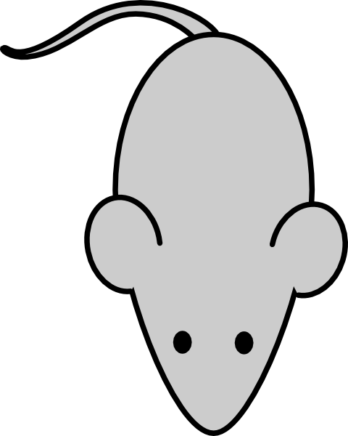
Smoking Study Design 3
Randomly partition 50 mice into 10 chambers with 5 mice each
Randomly assign 5 of 10 chambers to receive smoke
Mice put in same chamber each day
Detect presence/absence of cancer in each mouse
What are the EUs and OUs in this experiment?

Slide 19
Pseudo-replication: confusing Ous with EUs
Every EU receives independent treatment application
OUs from EU receive same treatment application
Different from “receiving the same treatment”
Thinking of OUs as EUs is called pseudo-replication of a treatment
Assumes you have more information about treatments than you really do
Leads to larger Type I errors

Slide 20
Learning objectives Review
Identify if a given data collection procedure is an observational study or randomized, comparative experiment
Define experimental unit, observational unit, treatment factor, etc.
Explain what pseudo-replication is
Explain purpose of randomization

